Slide 1
Git CleanUp
Terje Sandstrøm, Solidify, 2020

Slide 2
You are a master of
Clone
Commit
Pull
Fetch
Push
Branch
Merge
Remote

Slide 3
Short recap of Git structure
Remote Repository
Fetch
Push
Git repo
Local Repository
Pull
Commit
Index/Staging area
Checkout
Workspace
Add

Slide 4
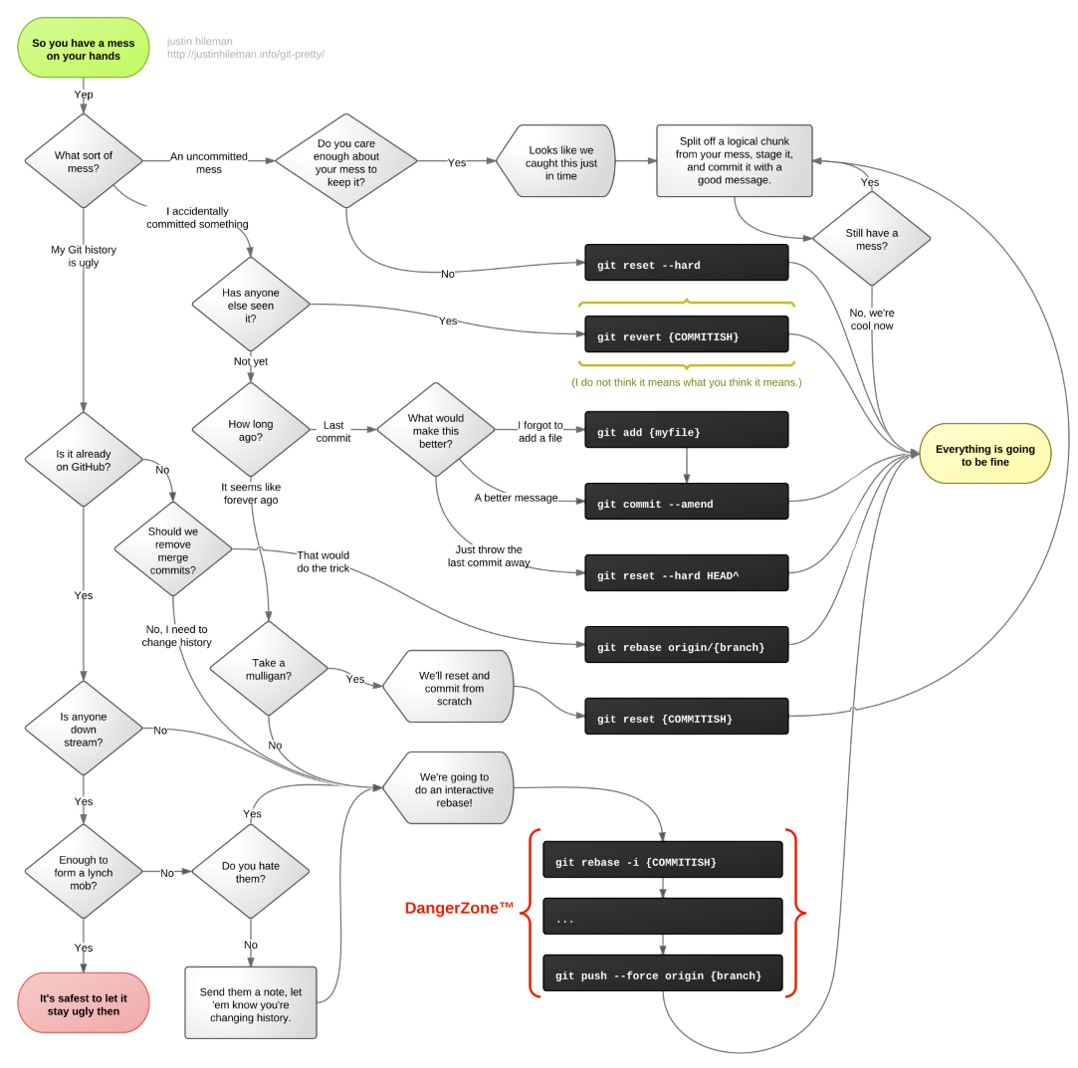
http://justinhileman.info/article/git-pretty/

Slide 5
Commit amend
Do a change
Commit (DON’T PUSH IT)
Do another change
Add files, change message
This changes local history, and creates orphans

Slide 6
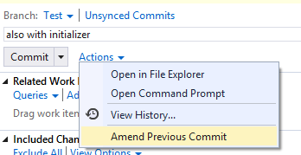
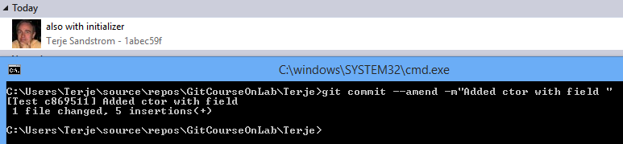
Commit --amend
Amend a commit
Sequentially add commits together to form a single commit
Change the last commit
Content
Commit comment
Git commit –amend –m”New msg”
ONLY before push

Slide 7


Slide 8
Delete branches
Locally:
Git branch –d/-D Whatever
Capital D means: Forced, even if it hasn’t been pushed or merged
Remote:
Git push origin –delete Whatever
Remove local branches no longer on server
Git remote prune origin

Slide 9
Delete multiple branches
Git for-each-ref –format= '%(refname:strip=2)’ refs/heads/bugs | grep –v master | xargs git branch –d
Alternative
Git branch <searchterm> | xargs git branch -d

Slide 10
I have modified files and want to undo
Go back to before any changes was done:
Git restore . (Note the dot)
Git restore affects the working directory
Undo a single file:
Git restore myfile

Slide 11
Undo last modified files
Git command line
>Git reset --hard
Undoes all changes
>Git reset –hard filename
Undoes the particular file

Slide 12
Getting things back to start
Do a change to the class
>Git restore .
Now the change is removed.
Do another change, stage the change
>Git restore .
Nothing seems to change, right ?
Git checkout affects the working tree! Not the index!

Slide 13
How to undo if staged
If staged
Git reset –hard // cleans both index and working tree

Slide 14
Git reset - moving your HEAD pointer
https://git-scm.com/book/en/v2/Git-Tools-Reset-Demystified

Slide 15
A file moving through versions
V1
V2

Slide 16
Git reset
V2
V1
Repo
V2
V2
--soft
Index/Stage
V2
V2
Workspace

Slide 17
Git reset
V2
V1
Repo
V2
V1
--mixed
(Default)
Index/Stage
V2
V2
Workspace

Slide 18
Git reset
V2
V1
Repo
V2
V1
--hard
Index/Stage
V2
V1
Workspace

Slide 19

Git tree movements visualized
History
Git commit
Stage/Index
Git reset --soft …..
Git checkout
Git reset (--mixed) …..
Working directory
Git add …
Git reset –hard …..

Slide 20

Visual Studio hickup:
Change 1:
Add a new class (Don’t commit)
Create a new branch
Notice: You can easily switch to the new branch and back and forth to master
Change 2:
Do a change in existing class1
Switch branch: You may get

Slide 21
How to fix a mess like this:
Change 2:
>git reset –hard
I loose the changes to exiting class, but the new class exist
After this reset, we can switch branch and commit the new class.
If I Want to keep the first change, I must commit that file alone in master, or I can stash it.
This file is not tracked
> git add filename
> git commit
Notice: Commit on cmd line only commits what is in the index, Commit in VS stages AND commits.

Slide 22
How to remove the added class
We now have only untracked files left
VS may show it as Included, and nothing in Untracked, but ‘git status’ will show the truth
>git clean –f
This will remove the last file

Slide 23
Git reset (undo things)
Undo from staging: (After add, before commit)
Git reset HEAD <filename>
Undo things in working folder
Git checkout . (all)
Git checkout -- <filename>
Undo
http://git-scm.com/docs/git-reset

Slide 24
Undo committed things
Locally, both commit and working tree
Git reset –hard HEAD
Remote:
Git revert HEAD~1
https://www.atlassian.com/git/tutorial/undoing-changes#!revert

Slide 25
Setting up a more usable editor
Download Notedpad++
http://notepad-plus-plus.org/download/v6.6.2.html
Edit .gitconfig at c:\users\(yourusername)
[core]
autocrlf = true
editor = 'C:/Program Files (x86)/Notepad++/notepad++.exe'

Slide 26
Changing after push
You must revert the change
Do a change to your file
Commit (you may or may not push)
Think hard, and regret what you did ……….
>Git revert HEAD --no-edit

Slide 27
Reset versus Revert
Revert
A
B
-B
= A
Reset
A
B
= A

Slide 28
I have committed and now I regret that
Experiment:
Change a method, and commit the change

Slide 29
I have committed and now I regret that solutions
I want to trash it, that code was awful!
>git reset –hard HEAD~1
I wasn’t finished, I want to add more to the same commit, but keep the changes, just undo my commit.
>git reset HEAD~1 (aka git reset –mixed ……)
Same as 2, but I will keep it staged, just going to add some more files
>git reset –soft HEAD~1

Slide 30
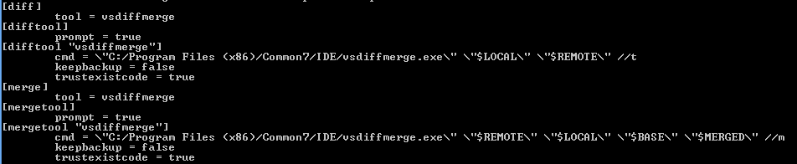
Setting up the merge tool for command line
Add section to global .gitconfig
Download from https://gist.github.com/OsirisTerje/42a913d2920723bc777a
(May need to add paths)

Slide 31
Fast forwarding merges
Experiment:
Ensure origin/master is aligned with master (do a push)
Create a new branch “Dev88”
Change the DoSomething method
The branch tree is now linear, Dev88 is just ahead of master
We can now forward merge master to Dev88

Slide 32
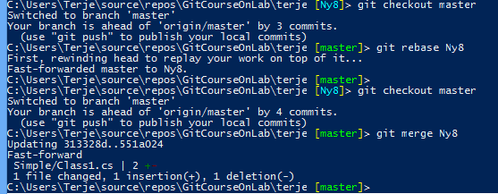
FF
Using rebase
Select master branch
>git rebase Dev88
Using merge
Select master branch
>git Merge Dev88

Slide 33
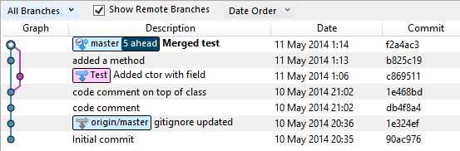
Cleaning up merge commits
Work:
Create and Checkout Branch “Test”
Change Class1
Switch back to Master
Change class1 somewhere else
Merge in branch Test
Watch the Sourcetree log.

Slide 34
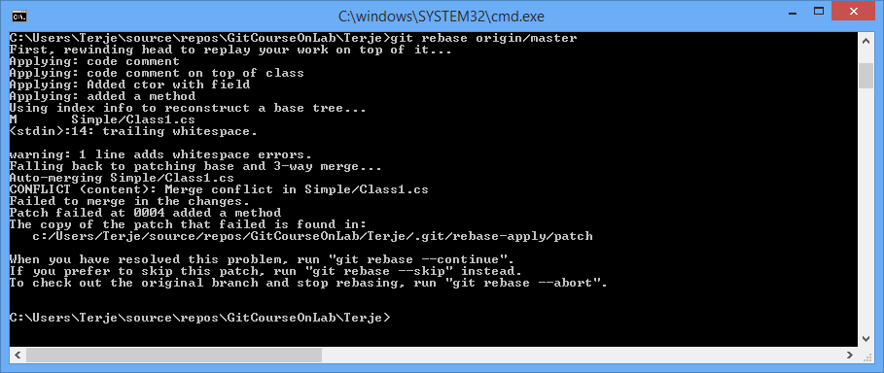
How to clean up the merges
> Git rebase origin/master
If conflict:
Don’t edit the shown mergefile with a lot of >>>>>>>> markers in
This is NOT your source file !!!!
> Git mergetool

Slide 35
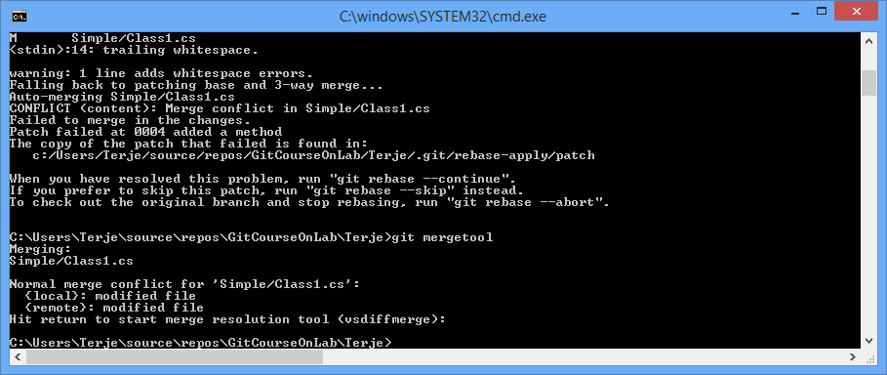
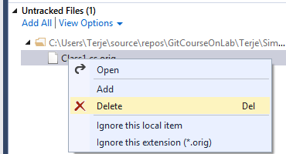
Git rebase –continue
Remove trash
Consider adding .orig to gitignore

Slide 36
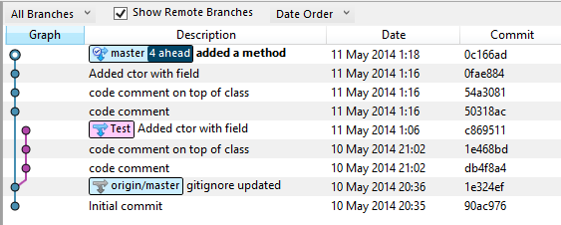
The result
The merge commit has been eliminated!
But Beware:
History has been rewritten !
(Don’t do rebasing if you have pushed your commits! But not an issue in this case since we rebase to origin/master)

Slide 37
Working in master or branch
Preferably work in a dev branch
Commit often
Merge often
Consider doing a rebase origin to get rid of the merge commits
Pull to master, merge over to the dev branch
Alternative: pull rebase !

Slide 38
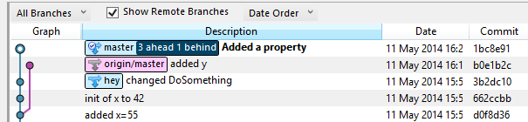
Experiment with multiple developers
Join up 2 persons, on same repo
Dev1:
Do a change, commit and push
Dev2:
Do own change. Sees this in SourceTree

Slide 39
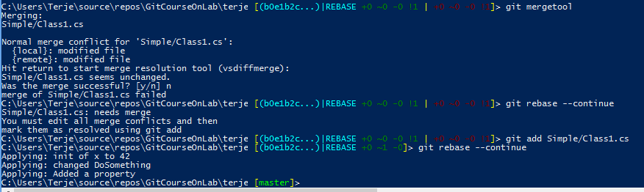
Dev 2 decide on a pull rebase
>git pull –rebase
Patch may or may not fail, assume it fails:
>Git mergetool
Starts the VS merge, resolve the merge

Slide 40
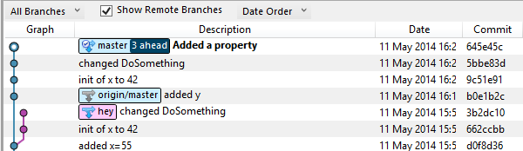
Sourcetree before/after “merge” (rebase)

Slide 41
Merge branches using rebasing
I don’t want the merge commits
Alt.1:
Merge the standard way
Use rebase origin/{branch} to get rid of the merge commits
Alt.2:
“Merge” using rebasing instead
Rebase : Add changes on top of latest target branch changes.

Slide 42


Experiment: Rebase “merging”
Create a branch off master, call it devX
Switch to it
Add a new class here
Switch to master
Change something here
Forward merge master

Slide 43
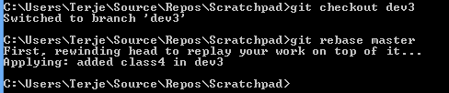


Rebase devX on top of master
Git checkout dev2 // The branch which will be rebased on top of the next one
Git rebase master // the branch we will rebase onto
Forward merge master after this:
Go to the "oldest" branch, merge the "newest" branch into the oldest
That way the oldest is moved forward to the newest.
Git checkout master, git rebase dev3

Slide 44


Squashing – combining commits
Experiment:
Create a new branch , Ny10
Make a change, commit
Make another change, commit
Checkout master
>git merge –squash Ny10
>git commit –m”Squashed…”

Slide 45
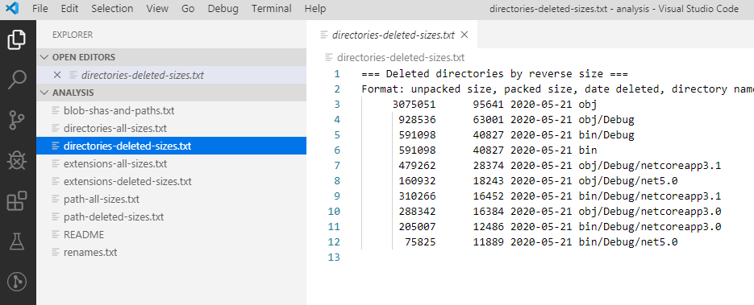
Filter-repo analysis
code .git/filter-repo/analysis

